Slide 1


News Category Classification for Enhanced News Delivery
Notes:
This project aims/focuses on building a news category classification system that can automatically assign news articles to their appropriate categories such as news, technology, politics and others. So, what would be the reason of creating this solution, in the next slide, we’ll talk about that.

Slide 2

Table of Contents
1. Business Problem |  |  | 2
2. Proposed Solution |  |  | 5
3. Solution Pipeline |  |  | 8
4. Data Pre-Processing |  |  | 14
5. Model Selection |  |  | 18
6. Solution Impact |  |  | 24
Copyright © 2023 Grazitti Interactive. The Information on the deck is proprietary to Grazitti Interactive.
Any reproduction or distribution of the content without the company's consent is prohibited and may cause legal action.
Notes:
alignment

Slide 3
Business Problem
Copyright © 2023 Grazitti Interactive. The Information on the deck is proprietary to Grazitti Interactive.
Any reproduction or distribution of the content without the company's consent is prohibited and may cause legal action.
‹#›
Notes:
Talk about building a solution to categorization requires a carefully strategized pipeline and so on

Slide 4
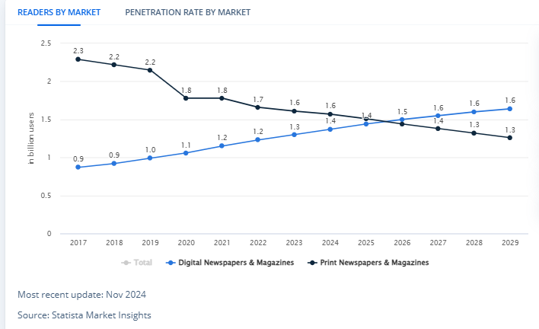
Business Context
Readership Growth In The Digital Landscape
Statista Market Insight
Digital News: Net increase of 500M users (2017-2024).
Printed News: Net Decrease of 700M users (2017-2024).
A shift from printed to digital news.
Consumer Preferences
On-Demand Consumption
Personalization
Timeliness of News Delivery
Accurate News
Copyright © 2023 Grazitti Interactive. The Information on the deck is proprietary to Grazitti Interactive.
Any reproduction or distribution of the content without the company's consent is prohibited and may cause legal action.
‹#›
Notes:
Firstly, let’s talk about the categorization of articles in Printed newspaper and magazines. If we look at it, most certainly for any news organization the number of pages in a newspaper and magazines are fixed. Let’s say 10 pages for a newspaper and 40 pages for a magazine. For this only a few experienced editors can correctly categorize the articles that are to be printed as the number of pages are not that much.
Now, Let’s see what the chart at the left shows. This chart by statistic Market Insights, an organization which tracks different metrics when it comes to anything related to news.
The chart shows the growth of digital newspapers and magazines. It can be seen that from 2017 to 2024, the market has significantly shifted from printed newspapers to digital ones, Around 500M increase in the number of users for digital platforms. Now when it comes to digital, there is no set number for articles to be printed, the news streams all day as new information comes to light. With this comes the problem, with users starting to focus more on digital platforms, the process of categorizing N number of articles everyday is just not feasible to done through manual work, which is more often than not prone to human error. For an organization, with the increase of news articles per day it can not just keep hiring more editors, as it will create significant costs, like the increase in salaries, increase in workforce, training new editors so that they understand how each articles falls into a category. The main issue is scalability. Now how can we solve this problem?
https://www.statista.com/outlook/amo/media/newspapers-magazines/worldwide

Slide 5
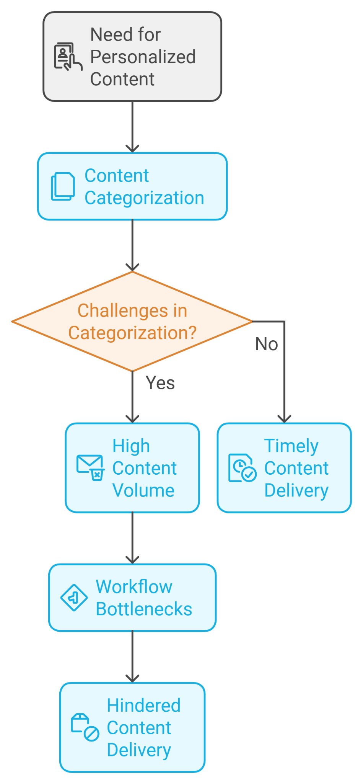
Business Problem: Challenges
Personalization Needs
Users expect tailored content (e.g., politics, sports, tech). Inaccurate categorization can result in irrelevant recommendations, poor user experience, and reduced engagement.
High Content Volume
Rising demand requires faster organization and publishing. Delays in categorization hurt reader engagement and relevance.
Workflow Bottlenecks:
Manual categorization is slow, inconsistent, and struggles with real-time classification, especially during peak traffic or breaking news causing them to lose users in a competitive market.
Copyright © 2023 Grazitti Interactive. The Information on the deck is proprietary to Grazitti Interactive.
Any reproduction or distribution of the content without the company's consent is prohibited and may cause legal action.
‹#›
Notes:
Firstly, let’s talk about the categorization of articles in Printed newspaper and magazines. If we look at it, most certainly for any news organization the number of pages in a newspaper and magazines are fixed. Let’s say 10 pages for a newspaper and 40 pages for a magazine. For this only a few experienced editors can correctly categorize the articles that are to be printed as the number of pages are not that much.
Now, Let’s see what the chart at the left shows. This chart by statistic Market Insights, an organization which tracks different metrics when it comes to anything related to news.
The chart shows the growth of digital newspapers and magazines. It can be seen that from 2017 to 2024, the market has significantly shifted from printed newspapers to digital ones, Around 500M increase in the number of users for digital platforms. Now when it comes to digital, there is no set number for articles to be printed, the news streams all day as new information comes to light. With this comes the problem, with users starting to focus more on digital platforms, the process of categorizing N number of articles everyday is just not feasible to done through manual work, which is more often than not prone to human error. For an organization, with the increase of news articles per day it can not just keep hiring more editors, as it will create significant costs, like the increase in salaries, increase in workforce, training new editors so that they understand how each articles falls into a category. The main issue is scalability. Now how can we solve this problem?
https://www.statista.com/outlook/amo/media/newspapers-magazines/worldwide

Slide 6
Proposed Solution
Copyright © 2023 Grazitti Interactive. The Information on the deck is proprietary to Grazitti Interactive.
Any reproduction or distribution of the content without the company's consent is prohibited and may cause legal action.
‹#›
Notes:
Talk about building a solution to categorization requires a carefully strategized pipeline and so on

Slide 7
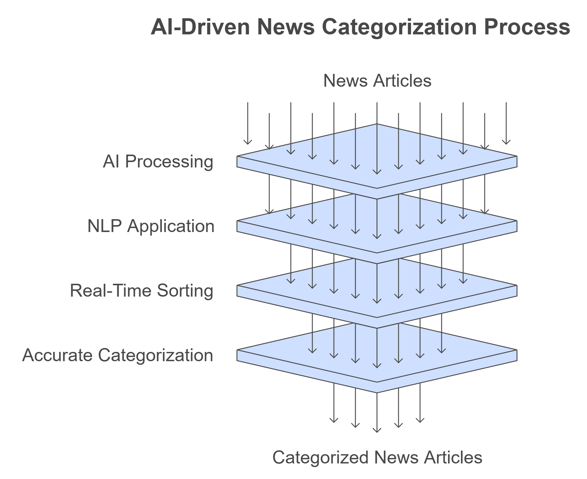
AI-Based News Classification
Proposed Solution
Implementation of AI to deal with business problems.
Leverages natural language processing (NLP) to sort news into relevant categories efficiently.
Real time processing and sorting of news articles for better organization.
Provides scalability by handling vast values of digital news with accuracy.
Copyright © 2023 Grazitti Interactive. The Information on the deck is proprietary to Grazitti Interactive.
Any reproduction or distribution of the content without the company's consent is prohibited and may cause legal action.
‹#›
Notes:
AI-BASED News Classification. The solution proposed is based on state of the art Natural Language processing models that are built to extract and understand information from natural language. Now, this solution will directly deal with the issue discussed previously.
Streamlined categorization - Right as the data comes, the solution can accurately detect and tag the news articles to their appropriate categories. This in turn will help reduce costs that are associated with manual categorization and also deal with the issues of scalability.
With high accuracy, this solution will also deal with this issue of human-error which becomes common when working on a larger scale which is why so many companies try to introduce automation into their processes.
It also enhances the efficiency, directly tagging the articles in real-time so that the news can be processed and tagged immediately and sent out to the users.
With all of the improvements discussed, it ultimately increases the quality of news and with that the consumers can stay satisfier and have an amazing user experience. With all these improvements there are some expectations of benefits for the news organizations and users as well which we’ll discuss in the next section

Slide 8
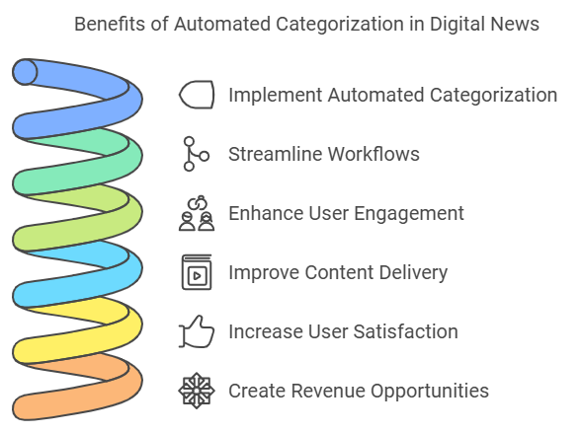
AI-Based News Classification: Benefits
Enhanced Personalization:
Accurately categorizes articles, providing tailored recommendations that improve user satisfaction and retention.
Faster Publishing:
Automates categorization to handle high content volumes, ensuring timely delivery and improved user engagement.
Scalable Workflows:
Handles real-time classification during peak traffic, reducing delays and maintaining competitiveness in the market.
Improved User Experience:
Eliminates bottlenecks, ensuring consistent and relevant content delivery to retain users.
Increased Revenue Opportunities:
Engaged users and better content targeting drive higher ad performance and subscription growth.
Copyright © 2023 Grazitti Interactive. The Information on the deck is proprietary to Grazitti Interactive.
Any reproduction or distribution of the content without the company's consent is prohibited and may cause legal action.
‹#›
Notes:
AI-BASED News Classification. The solution proposed is based on state of the art Natural Language processing models that are built to extract and understand information from natural language. Now, this solution will directly deal with the issue discussed previously.
Streamlined categorization - Right as the data comes, the solution can accurately detect and tag the news articles to their appropriate categories. This in turn will help reduce costs that are associated with manual categorization and also deal with the issues of scalability.
With high accuracy, this solution will also deal with this issue of human-error which becomes common when working on a larger scale which is why so many companies try to introduce automation into their processes.
It also enhances the efficiency, directly tagging the articles in real-time so that the news can be processed and tagged immediately and sent out to the users.
With all of the improvements discussed, it ultimately increases the quality of news and with that the consumers can stay satisfier and have an amazing user experience. With all these improvements there are some expectations of benefits for the news organizations and users as well which we’ll discuss in the next section

Slide 9
Solution Pipeline
Copyright © 2023 Grazitti Interactive. The Information on the deck is proprietary to Grazitti Interactive.
Any reproduction or distribution of the content without the company's consent is prohibited and may cause legal action.
‹#›
Notes:
Firstly, let’s talk about the categorization of articles in Printed newspaper and magazines. If we look at it, most certainly for any news organization the number of pages in a newspaper and magazines are fixed. Let’s say 10 pages for a newspaper and 40 pages for a magazine. For this only a few experienced editors can correctly categorize the articles that are to be printed as the number of pages are not that much.
Now, Let’s see what the chart at the left shows. This chart by statistic Market Insights, an organization which tracks different metrics when it comes to anything related to news.
The chart shows the growth of digital newspapers and magazines. It can be seen that from 2017 to 2024, the market has significantly shifted from printed newspapers to digital ones, Around 500M increase in the number of users for digital platforms. Now when it comes to digital, there is no set number for articles to be printed, the news streams all day as new information comes to light. With this comes the problem, with users starting to focus more on digital platforms, the process of categorizing N number of articles everyday is just not feasible to done through manual work, which is more often than not prone to human error. For an organization, with the increase of news articles per day it can not just keep hiring more editors, as it will create significant costs, like the increase in salaries, increase in workforce, training new editors so that they understand how each articles falls into a category. The main issue is scalability. Now how can we solve this problem?
https://www.statista.com/outlook/amo/media/newspapers-magazines/worldwide

Slide 10
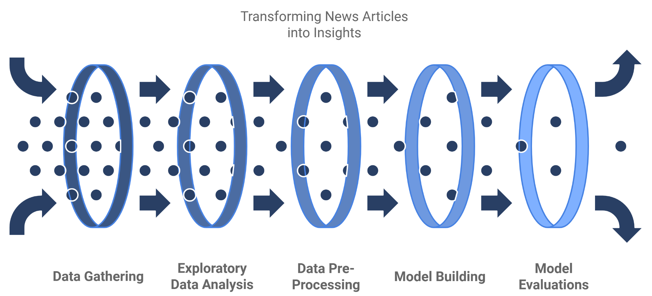

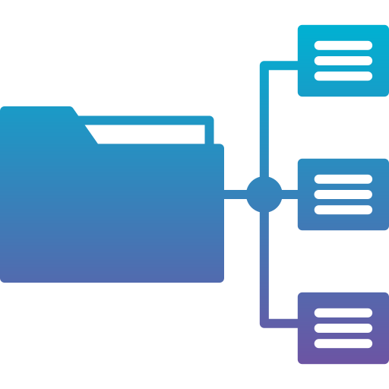
Solution Pipeline: Key Stages
Collecting Diverse News Articles
Analyzing data patterns and trends
Cleaning and Structuring data
Developing classification models
Assessing model performance
Copyright © 2023 Grazitti Interactive. The Information on the deck is proprietary to Grazitti Interactive.
Any reproduction or distribution of the content without the company's consent is prohibited and may cause legal action.
‹#›
Notes:
This is the pipeline through which the solution is created. For now, I’ll give you an overview of all the stages involved starting with gathering the data to eventually creating this solution.
So, we start with gathering the data which is enough to train and test the best Natural language processing models.
Once we have the data we move ahead in exploring the data, validating the data, looking for trends or important pieces of information. Once, we truly understand what the data is about we can move ahead to the next step which is
Pre-processing the data for our NLP models. It involves cleaning and standardizing or structuring the data so that the model can learn as much as possible about it.
The next phase is model building which usually involves experimentations with different models, finding out the best model and validating it, with multiple trained and tested models on our hand we can move ahead to see the nuances in between those models. Evaluate and compare all the models to find out the best performing model. Starting with just news articles, through all of these stages, we can create a solution that can accurately categorize those articles.

Slide 11




News Articles Dataset Overview
Source
Column Names
Public News data from HuffingtonPost available on Kaggle
Author
Headline
Short Description
Date
Category
Categories
Article Count
A total of 15 categories of News Articles like Politics, Black Voices, Wellness, etc.
Total of 210k headlines & description(rows), are present in the dataset
Copyright © 2023 Grazitti Interactive. The Information on the deck is proprietary to Grazitti Interactive.
Any reproduction or distribution of the content without the company's consent is prohibited and may cause legal action.
‹#›
Notes:
Let’s get an overview of the dataset first. The dataset was acquired from Kaggle, which gets it data from Publicly available news HuffingtonPost.
There were a total of 210k articles present in the dataset or in technical terms we can say 210k rows of data which were split in between 15 categories naming a few would be Entertainment, Politics, Parenting, Wellness etc.
The dataset also had 5 columns which helped in further analysis of the data like the Author name, the headline of the article, a short description of the article, The data it’s published and the category each article falls under.
Now that we have an understanding of structure of data we can move ahead in the process of Exploring the data to find out trends and other important information.

Slide 12
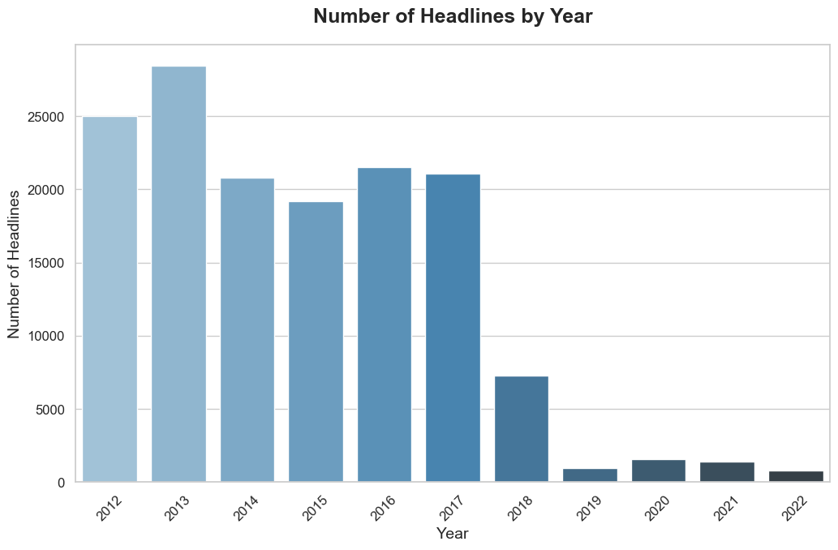
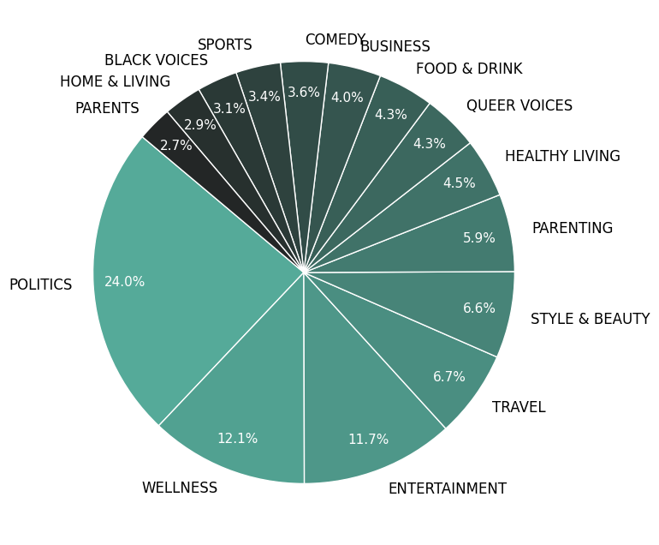
Data Exploration
Dataset time ranges from 2012-2022
48% of the data is divided between 3 categories
Copyright © 2023 Grazitti Interactive. The Information on the deck is proprietary to Grazitti Interactive.
Any reproduction or distribution of the content without the company's consent is prohibited and may cause legal action.
‹#›
Notes:
So while exploring the data, looking at the first chart, we found that the dataset date ranges starting from 2012 and upto 2022. It can also be seen that most of the data regarding the articles are before 2019.
Keeping that in mind, we checked the distribution of each category to see whether there are any discrepancies in the data. It was found out that 48% of the data is divided between 3 categories, which are Welness, Entertainment and Politics. So class-imbalance is an issue we will have to deal with.

Slide 13
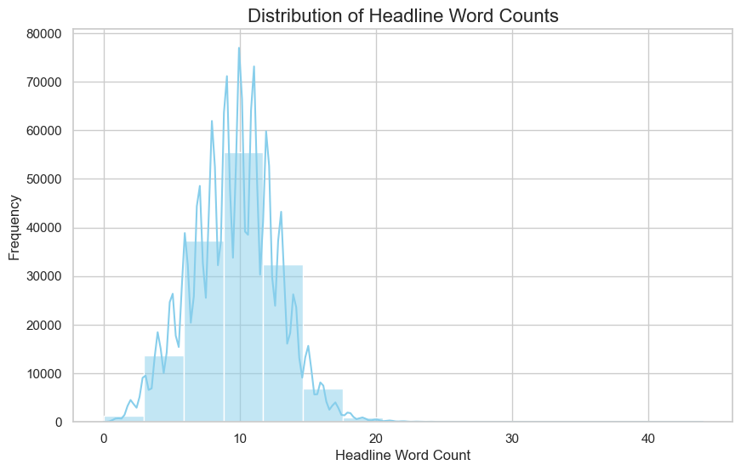
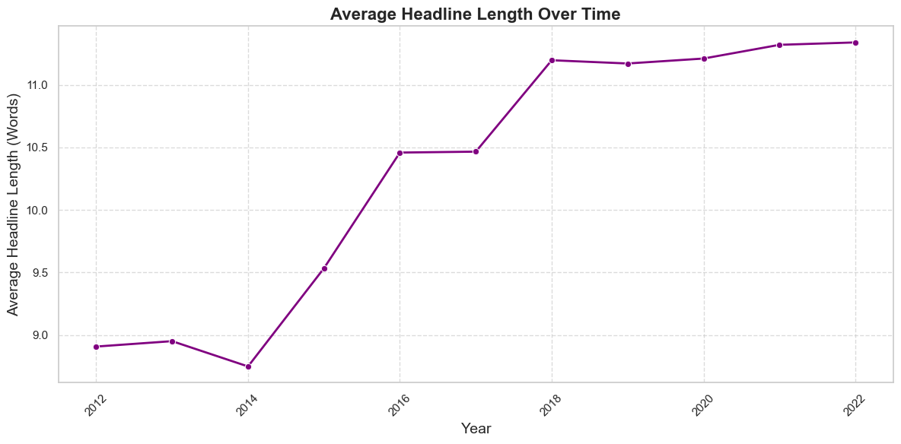
Data Exploration
Average length of the headlines is around 9-10 words
Average Headline length has increased by 2 words since the past decade
Copyright © 2023 Grazitti Interactive. The Information on the deck is proprietary to Grazitti Interactive.
Any reproduction or distribution of the content without the company's consent is prohibited and may cause legal action.
‹#›
Notes:
Next we check another important column in the dataset, which is headline, on which we plan to build our model. The left chart shows that the average length of the headline is around 9-10 words and the right chart shows how the average headline length has increased from 2012 till 2022, which is an increase of 2 words on an average.

Slide 14
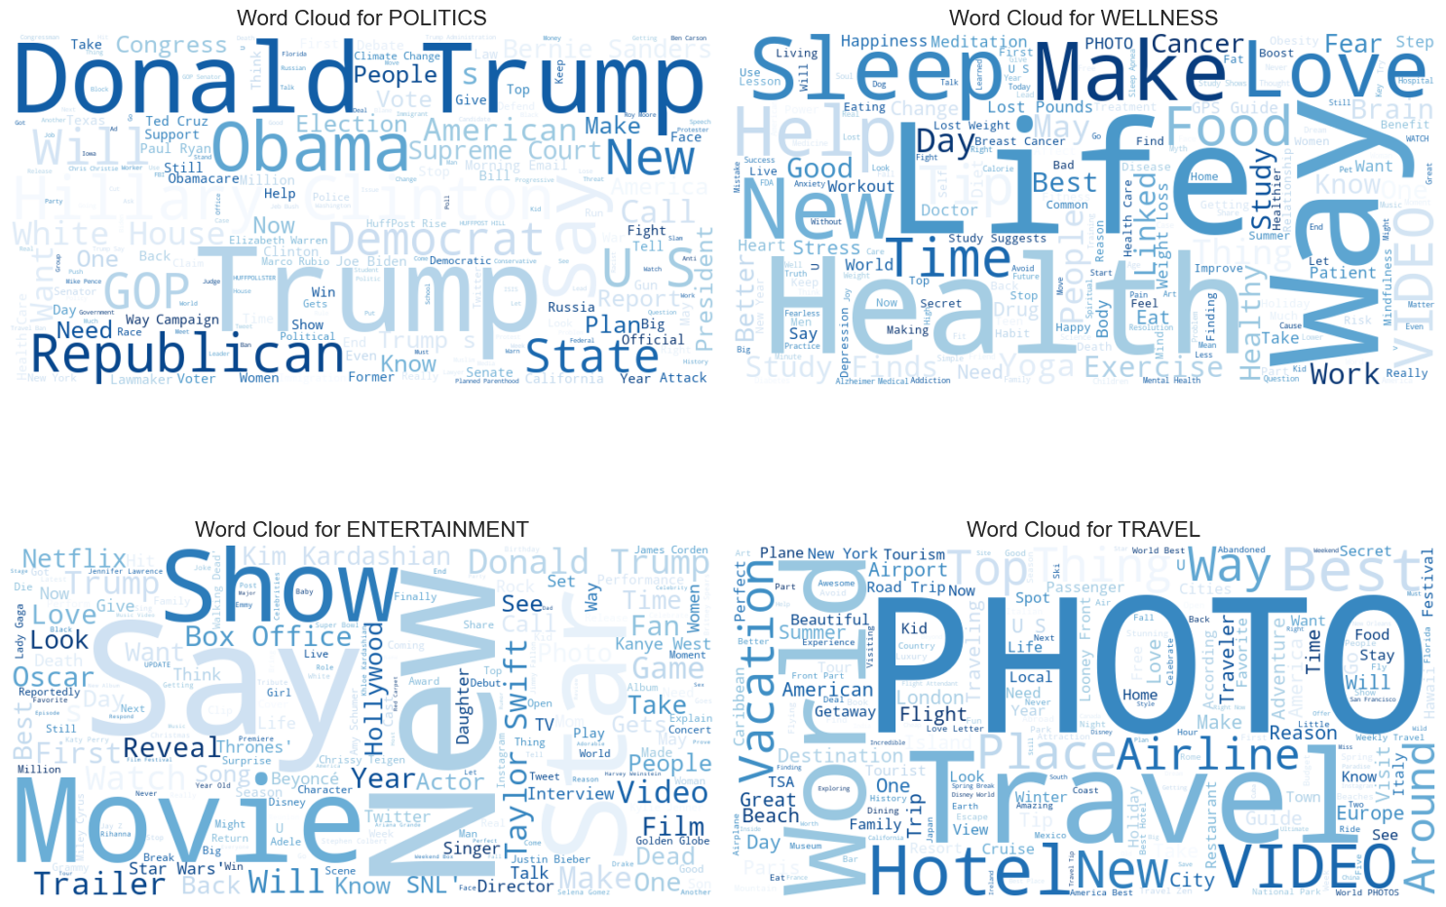
Data Exploration
Most common words in top 4 Categories
Copyright © 2023 Grazitti Interactive. The Information on the deck is proprietary to Grazitti Interactive.
Any reproduction or distribution of the content without the company's consent is prohibited and may cause legal action.
‹#›
Notes:
Next, Let’s look at word clouds of the top 4 most dominant categories. Politics being the most dominant category in regards to the distribution of data. We can see names like Donald Trump and Obama are the most repeated terms for politics indicating presential candidate names are the most often used words when in comes to the category of POLITICS.
When it comes wellness, words like SLEEP, LOVE, LIFE and HEALTH are most common
For Entertainment, SHOW, MOVIE, Names of artists like Taylor swift and funnily enough Trump again.
and for Travel, Hotel, AIRLINE, PHOTO, Vacation are some of the most common words.

Slide 15
Data Pre-Processing
Copyright © 2023 Grazitti Interactive. The Information on the deck is proprietary to Grazitti Interactive.
Any reproduction or distribution of the content without the company's consent is prohibited and may cause legal action.
‹#›
Notes:
talk about processing the data in the right way and so on

Slide 16


Challenges
Data Imbalance
Possible Techniques
Undersampling
Oversampling
Class Weights
Advanced Models(BERT)
Category Overlap
Multiple categories were seen to be extremely similar, interchangeable.
Using Cosine Similarity to Club similar categories
Copyright © 2023 Grazitti Interactive. The Information on the deck is proprietary to Grazitti Interactive.
Any reproduction or distribution of the content without the company's consent is prohibited and may cause legal action.
‹#›

Slide 17
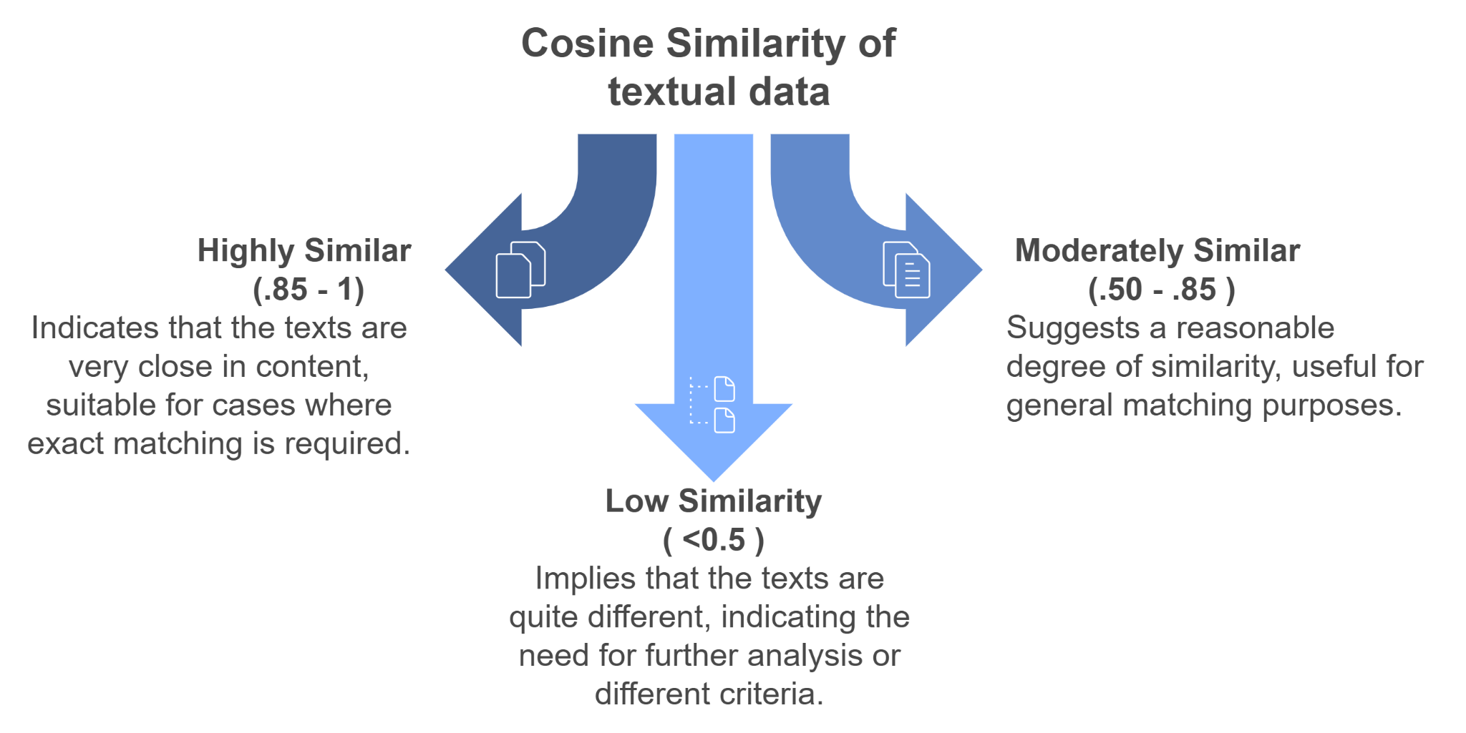
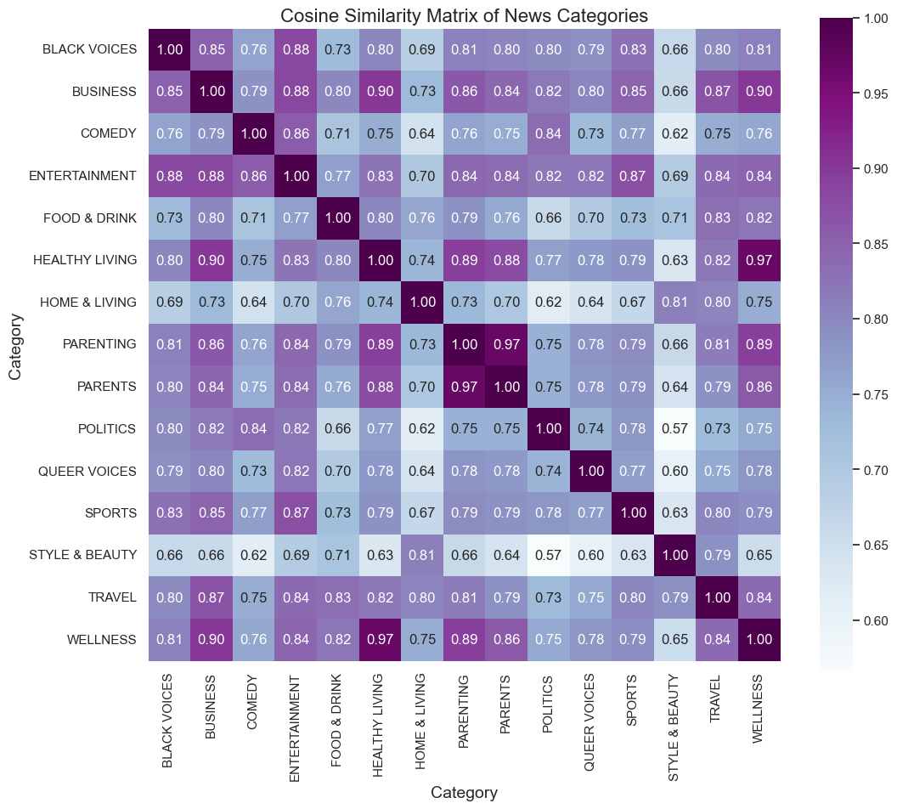
Data Pre-Processing
Similarities between classes
Wellness and Healthy Living (97%)
Parents and Parenting (97%)
Copyright © 2023 Grazitti Interactive. The Information on the deck is proprietary to Grazitti Interactive.
Any reproduction or distribution of the content without the company's consent is prohibited and may cause legal action.
‹#›
Notes:
While exploring the data we were also looking at some similarities and differences between multiple categories using the headlines of news articles. For this a method called cosine similarity was used which finds out similarities in between multiple texts. Anything greater than 90% or .90 are considered interchangeable. This method was used because while exploring the we saw two categories, “Parents” and “Parenting” which sound quite similar. Interestingly it was found out these two categories had a similarity value of 97% and the same goes for WELNNES and HEALTHY LIVING. These categories can be combined which will help increase the data of some of the categories which have less amount of data. The overall sentiment of the data was found out to be neutral(Vader Sentiment Analysis).

Slide 18
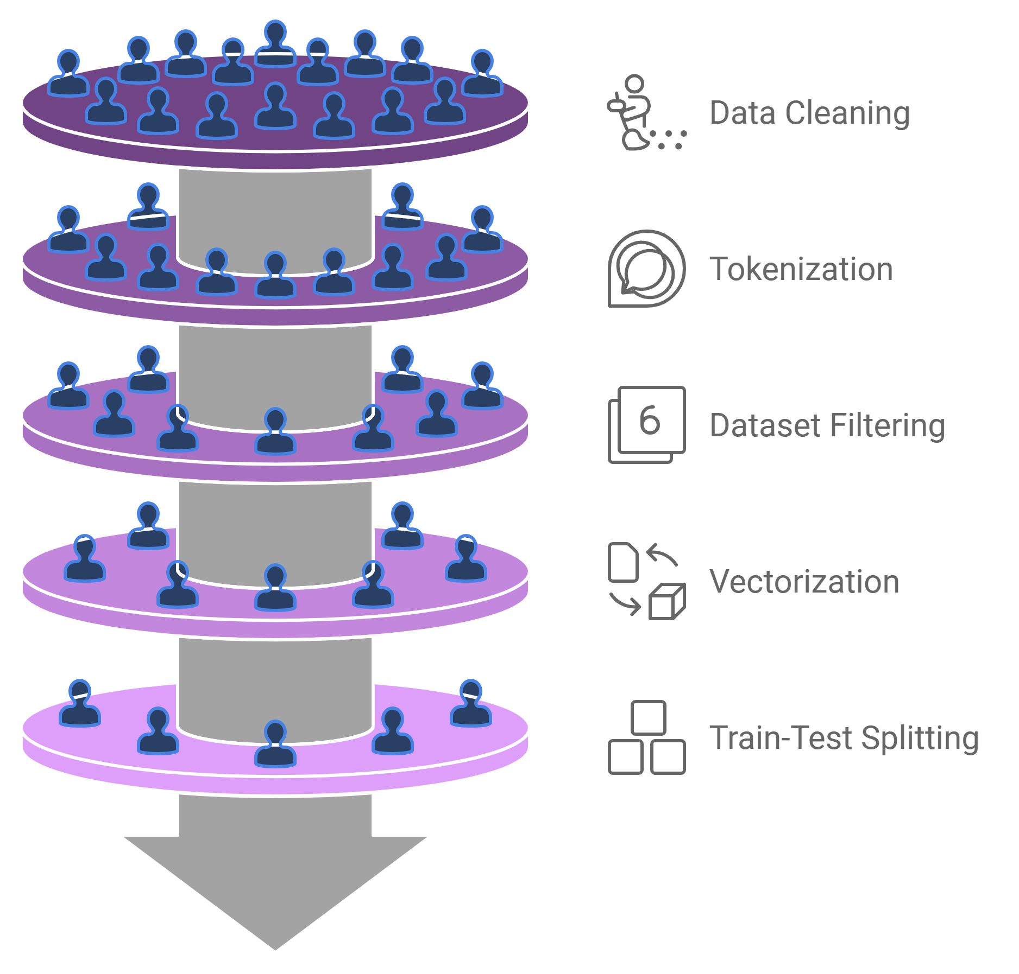
Data Pre-Processing
Basic Models
Advanced Models
Removing HTML Tags, Special Characters using Regular expressions
Same as Basic Models
Splitting Headlines into words, Lemmatization (Walking -> walk) using NLTK Library
Tokenization
Creating 2 datasets
(with & without Stopwords).
“The cat sat on mat”->“cat sat mat”
N/A
Tf-IDF Vectorization
Captures words importance
Generally better for classification
Embeddings
(word2vec,
Fastvec)
80-20% Train-Test split
Stratified split for proportional split
Copyright © 2023 Grazitti Interactive. The Information on the deck is proprietary to Grazitti Interactive.
Any reproduction or distribution of the content without the company's consent is prohibited and may cause legal action.
‹#›
Notes:
Now that we’ve extracted alot of information while exploring the data. Let’s have a look at the data-preprocessing pipeline. This step is imperative to the building of NLP model as it deals with cleaning, structuring and preparing the data that goes into the training and testing of models. We start with cleaning the data like removing empty rows, removing HTML characters or Special characters if there are any using regular expressions. Next comes the step of tokenization which essentially means splitting a sentence into words and using lemmatization which reduces a word to it’s dictionary form without losing the meaning of the word.
Next 2 datasets were created for initial experimentation one with and one without stop words. In the sentence The cat sat on mat, The and ON are considered stopwords.
For vectorization we used a technique called TF-IDF which generally performs better on classification tasks and is able to capture word important.
The data was split in a ratio of 80-20% and the split was stratified which keeps same proportion of data for testing as it were in training.

Slide 19
Model Selection
Copyright © 2023 Grazitti Interactive. The Information on the deck is proprietary to Grazitti Interactive.
Any reproduction or distribution of the content without the company's consent is prohibited and may cause legal action.
‹#›
Notes:
talk about processing the data in the right way and so on

Slide 20

Comprehensive Model Experimentation
Logistics Regression
(With Stopwords)
F1-Score: 69%
BERT
(Combined Classes)
F1-Score: 81.48%
Logistics Regression
(With Stopwords)
F1-Score: 69%
BERT
(Combined Classes)
F1-Score: 81.48%
Naive Bayes
(With Stopwords)
F1-Score:48%
Bi-LSTM
(Similar Categories)
F1-Score: 67%
BERT
(Combined Classes)
F1-Score: 81.48%
Logistics Regression
(Without Stopwords)
F1-Score: 68%
DistilBERT
(Combined Classes)
F1-Score:80.44%
Naive Bayes
(Without Stopwords)
F1-Score: 50%
DistilBERT
(UnderSampling)
F1-Score: 79%
Logistics Regression
(With Stopwords)
F1-Score: 69%
BERT
(Combined Classes)
F1-Score: 81.48%
Logistics Regression
(Without Stopwords)
F1-Score: 68%
DistilBERT
(Combined Classes)
F1-Score:80.44%
Basic Models
Advanced Models
Note: The main metrics for comparison are Recall and F1-Score, as they provide a more balanced evaluation by accounting for both majority and minority class performance individually.
Copyright © 2023 Grazitti Interactive. The Information on the deck is proprietary to Grazitti Interactive.
Any reproduction or distribution of the content without the company's consent is prohibited and may cause legal action.
‹#›
Notes:
An exhaustive modelling framework was used to train, test and experiment the different models. Trying out traditional machine learning models like logistic regression or Naive Bayes, To deep learning models like LSTM or BI-LSTM to state of the art models like BERT and ROBERTA and then thorough evaluation of comparison between each model was done to filter out the best performing model across all categories.
I’d also like to mention the main metrics for evaluation used were Recall and F1-score. Recall and F1-Score balance the evaluation by focusing on both the minority and majority class performance, offering a more comprehensive measure than accuracy alone.

Slide 21

Models Comparison
Metrics | Logistic Regression (With Stop-Words) | Logistic Regression (Without Stop-Words) | Bi-LSTM Model | BERT (Best Model)
Accuracy | 71% | 70% | 66% | 82%
Precision | 69% | 70% | 67% | 81%
Recall | 60% | 60% | 66% | 82%
F1-Score | 69% | 68% | 67% | 81%
Reasoning | High accuracy but low recall, indicating too many wrong predictions | Logistic regression with stop words performing a bit better | Increase in recall indicates better understanding | High F1-recall, context understanding has increased significantly.
Copyright © 2023 Grazitti Interactive. The Information on the deck is proprietary to Grazitti Interactive.
Any reproduction or distribution of the content without the company's consent is prohibited and may cause legal action.
‹#›
Notes:
After training and testing all the model we have the accuracy metrics of different models.
In the table, for traditional machine learning models. Logistic regression (with-stop words) was the best performing model. Keeping this in mind, since advanced models can understand the context of sentences we decided to stick with the dataset containing stop-words. The recall and F1-score wasn’t the good for these model. So a more advanced model based on neural networks were tested which is BI-LSTM model. As we can see in the table the accuracy has lessened but the recall and F1-score has increased which was a good indication of complex models understand sentences and contexts of those sentences. Next we tried out multiple SOTA models like ROBERTA, BERT and DISTILBERT and got our champion model which was BERT.
With recall of 82% and F1-score of 81% this model performed well across all categories.

Slide 22
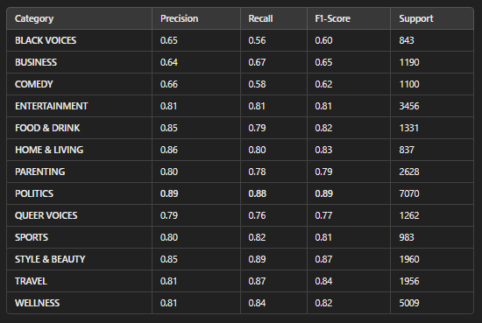
Champion Model
Top Performing Categories
Politics: Precision,recall and F1 score all at 89%
Style and Beauty: Excellent F1-Score of 87%
Travel: High Recall 87% and F1 score (84%).
Imbalanced Data
Reasonable outcomes for smaller classes like Black Voices and Business (>60%).
Demonstrates strong contextual understanding across diverse domains, consistently excelling in areas like Entertainment and Politics
Copyright © 2023 Grazitti Interactive. The Information on the deck is proprietary to Grazitti Interactive.
Any reproduction or distribution of the content without the company's consent is prohibited and may cause legal action.
‹#›
Notes:
Minority classes also display considerable performance
Slide contains most information

Slide 23
Hyperparameters of Champion Model
Default Model: BERT
Epochs | 10
Learning Rate | Default
Gradient Accumulation | None
Frozen Layers | None
Batch Size | 16
Hyperparameter Tuned Model: BERT
Epochs | 5
Learning Rate | 3e-5
Gradient Accumulation | 2 steps
Frozen Layers | First 6 layers
Batch Size | 32
Weighted Average F1: 80%
Underrepresented Classes
F1-Score (Black-Voices): 58%
F1-Score (Business): 63%
F1-Score (Comedy): 58%
Perform well for major categories, lacking in underrepresented categories.
Weighted Average F1: 81%
Underrepresented Classes:
F1-Score(Black-Voices):60%
F1-Score (Business): 65%
F1-Score (Comedy): 62%
Notable improvement in underrepresented groups while maintaining good performance in all others.
Copyright © 2023 Grazitti Interactive. The Information on the deck is proprietary to Grazitti Interactive.
Any reproduction or distribution of the content without the company's consent is prohibited and may cause legal action.
‹#›
Notes:
squeeze accuracy -> used hyperparameter tuning

Slide 24




Further Developments
Category Clarity
Refine overlapping categories to improve navigation, merging similar ones with high similarity.
Multilingual Approach
Expand multilingual support to enhance accessibility, inclusivity, and global usability by integrating additional languages beyond English.
Increase Dataset Size for Minority Classes
Source additional articles for minority classes to improve representation and ensure balanced coverage across all categories.
Leverage Better infrastructure
Using better infrastructure to train and test the model on headlines as well as short description to get near-perfect results.
Copyright © 2023 Grazitti Interactive. The Information on the deck is proprietary to Grazitti Interactive.
Any reproduction or distribution of the content without the company's consent is prohibited and may cause legal action.
‹#›

Slide 25
Solution Impact
Copyright © 2023 Grazitti Interactive. The Information on the deck is proprietary to Grazitti Interactive.
Any reproduction or distribution of the content without the company's consent is prohibited and may cause legal action.
‹#›
Notes:
talk about processing the data in the right way and so on

Slide 26

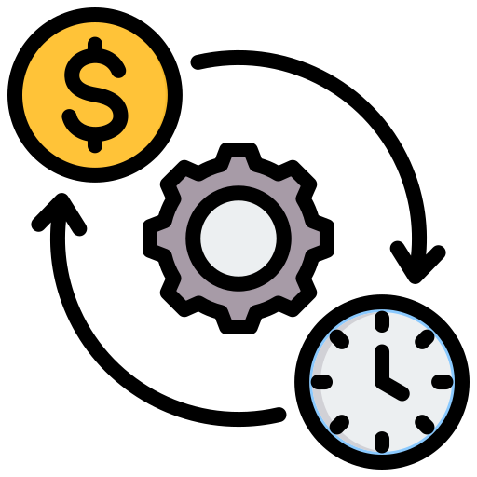


Business Impact
Time-Savings:
Automation of news categorization can save hundreds of hours in manual work.
Cost-efficiency:
Reducing manual tagging lowers costs and enhances scalability with fewer editorial resources.
Improved User Engagement:
Accurate categorization enhances recommendations, increasing platform time and ad revenue.
Revenue-Generation:
Premium personalized news feed and targeted advertising bases on news categories.
Copyright © 2023 Grazitti Interactive. The Information on the deck is proprietary to Grazitti Interactive.
Any reproduction or distribution of the content without the company's consent is prohibited and may cause legal action.
‹#›

Slide 27

THANKS

Slide 28
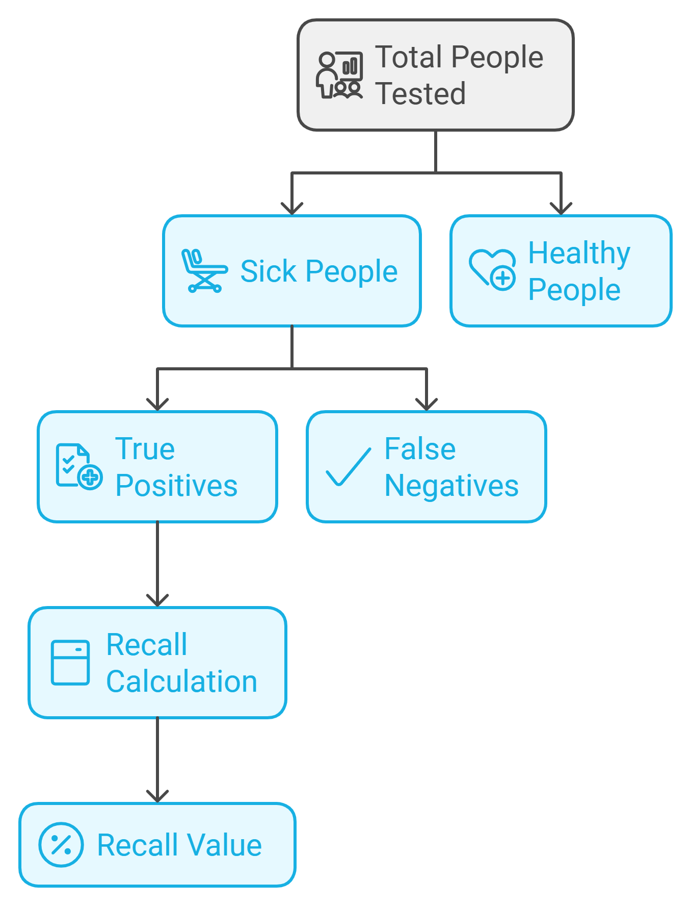
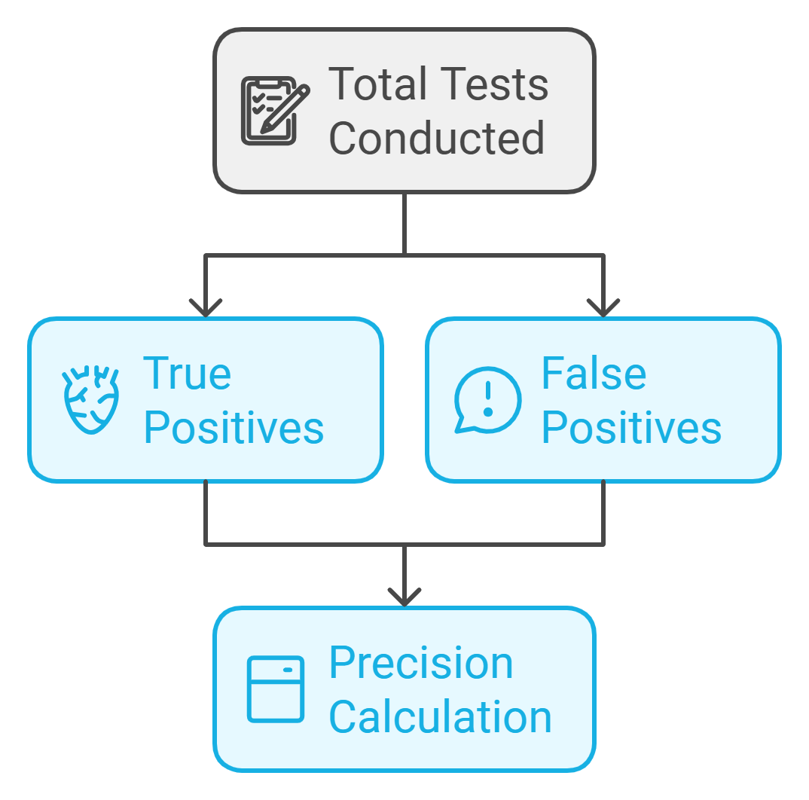
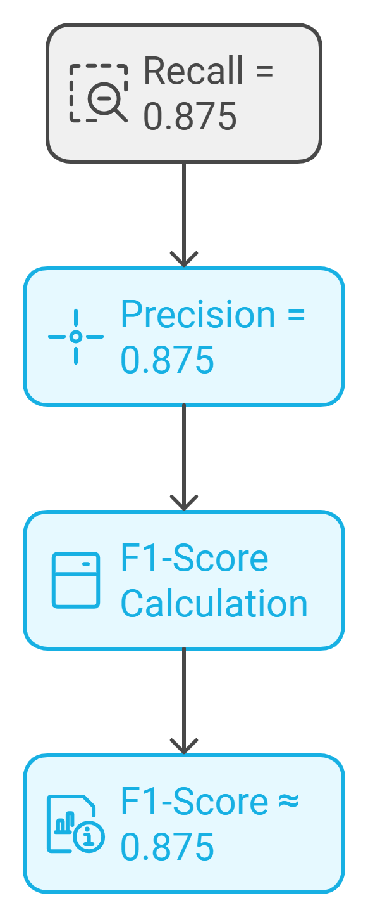
Appendix - Accuracy Metrics
Recall
Precision
F1-Score
Copyright © 2023 Grazitti Interactive. The Information on the deck is proprietary to Grazitti Interactive.
Any reproduction or distribution of the content without the company's consent is prohibited and may cause legal action.
‹#›

Slide 29
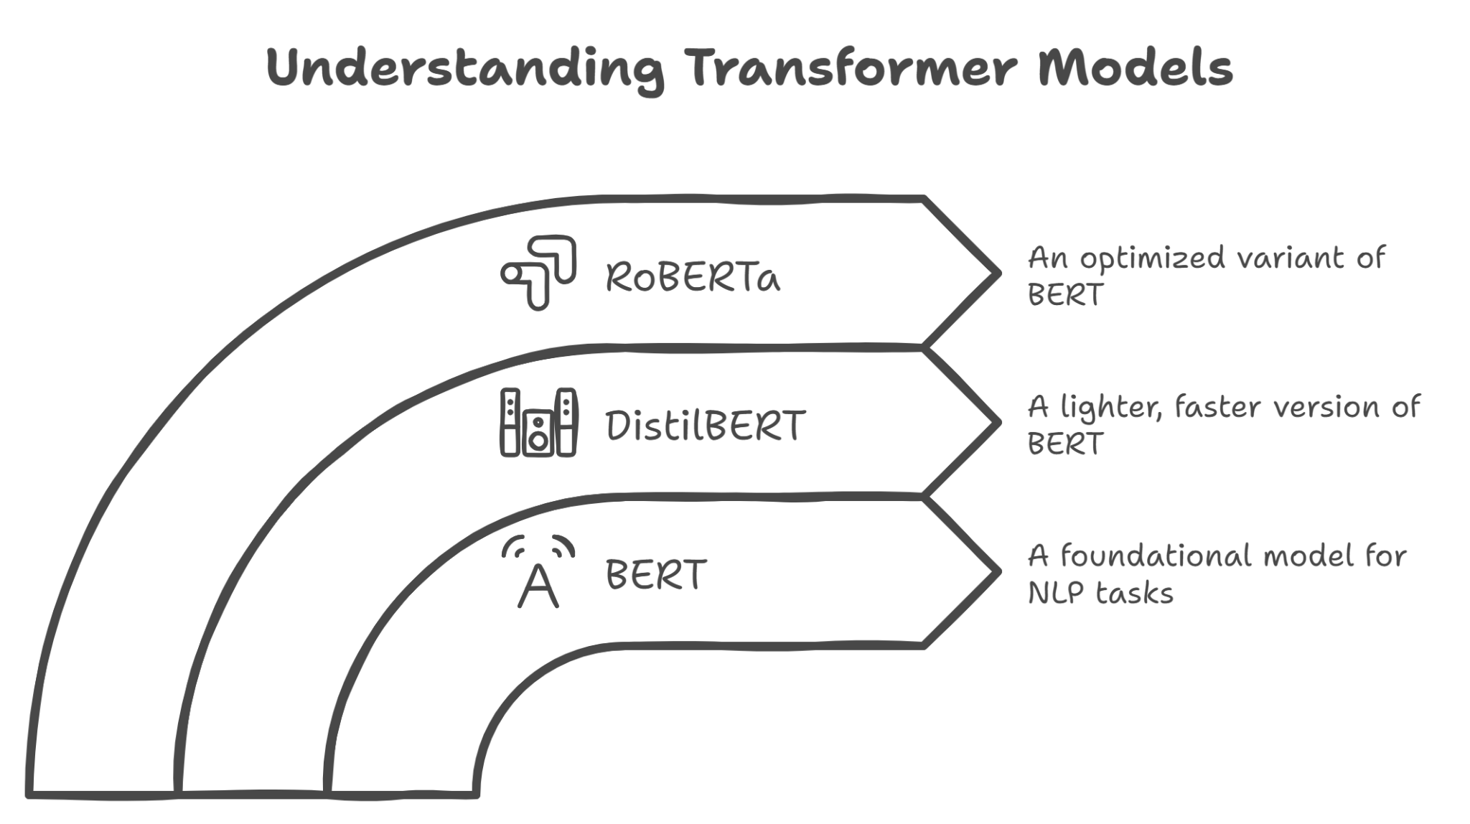
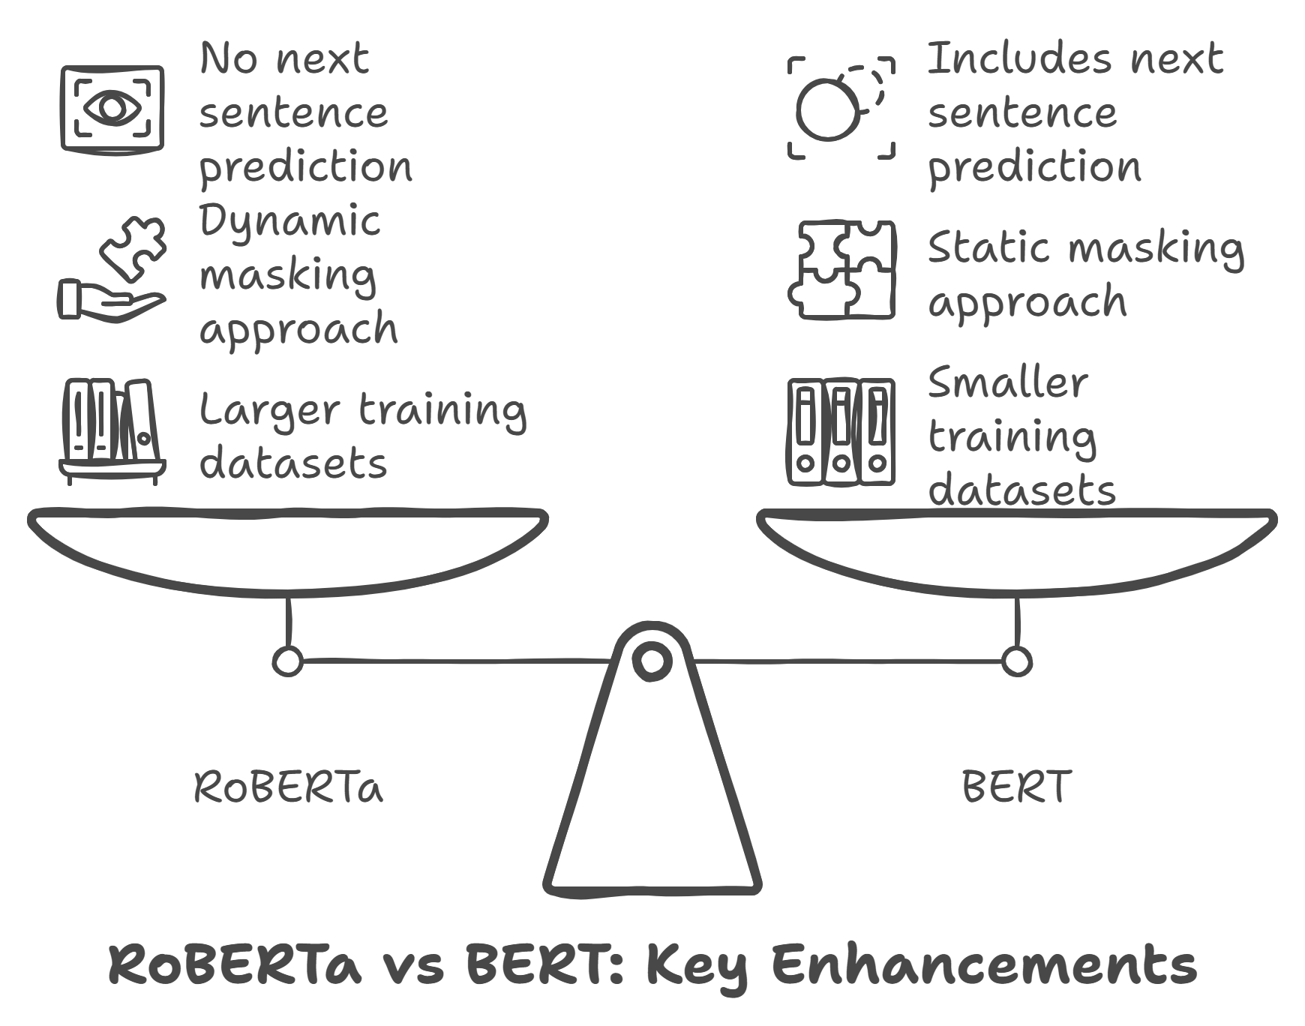
Appendix - Model Differences Transfer Learning
Copyright © 2023 Grazitti Interactive. The Information on the deck is proprietary to Grazitti Interactive.
Any reproduction or distribution of the content without the company's consent is prohibited and may cause legal action.
‹#›

Slide 30
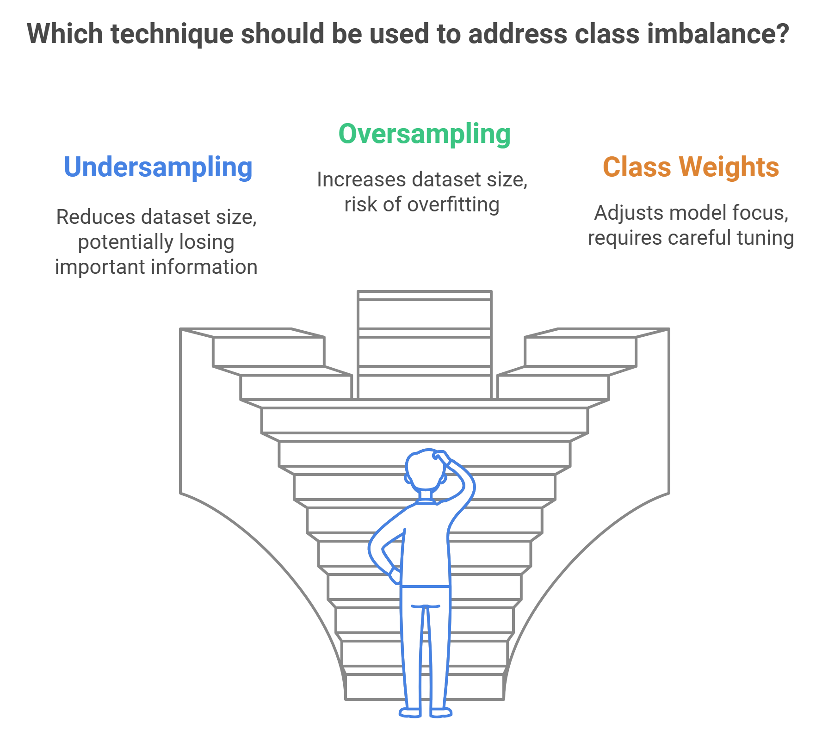
Appendix - Handling Class Imbalance
Copyright © 2023 Grazitti Interactive. The Information on the deck is proprietary to Grazitti Interactive.
Any reproduction or distribution of the content without the company's consent is prohibited and may cause legal action.
‹#›

Slide 31
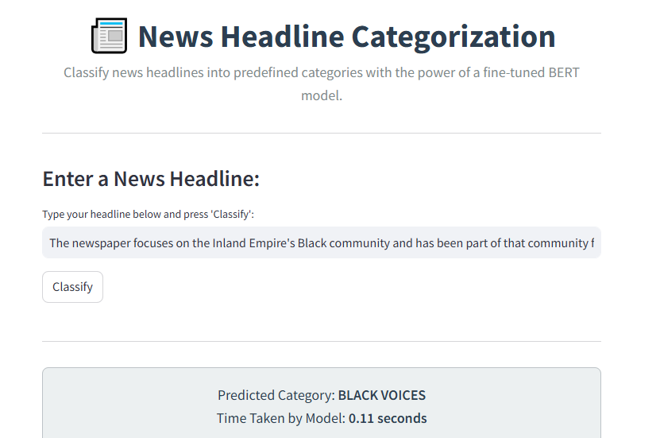
Appendix - Model Demonstration
Model Working
Enter any Headline from the internet to categorize it.
See the predicted category.
See the time taken to get prediction.
Headline length dictates time to get prediction.
(0.06S to 0.20S)
1000 articles carectorized in less than 2 minutes.
Copyright © 2023 Grazitti Interactive. The Information on the deck is proprietary to Grazitti Interactive.
Any reproduction or distribution of the content without the company's consent is prohibited and may cause legal action.
‹#›

Slide 32
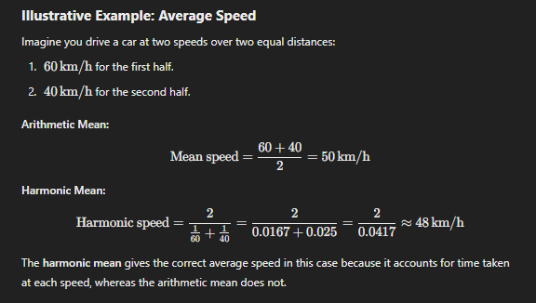
Appendix - Harmonic Mean Example
Copyright © 2023 Grazitti Interactive. The Information on the deck is proprietary to Grazitti Interactive.
Any reproduction or distribution of the content without the company's consent is prohibited and may cause legal action.
‹#›

